Slide 1





ASCEND! Team – Spring 2017
Nicholas Mallott, mallottn@erau.edu
Embry-Riddle Aeronautical University, Prescott
ASCEND! Team Lead
Arizona Space Grant Consortium – 4.22.2017 Symposium

Slide 2
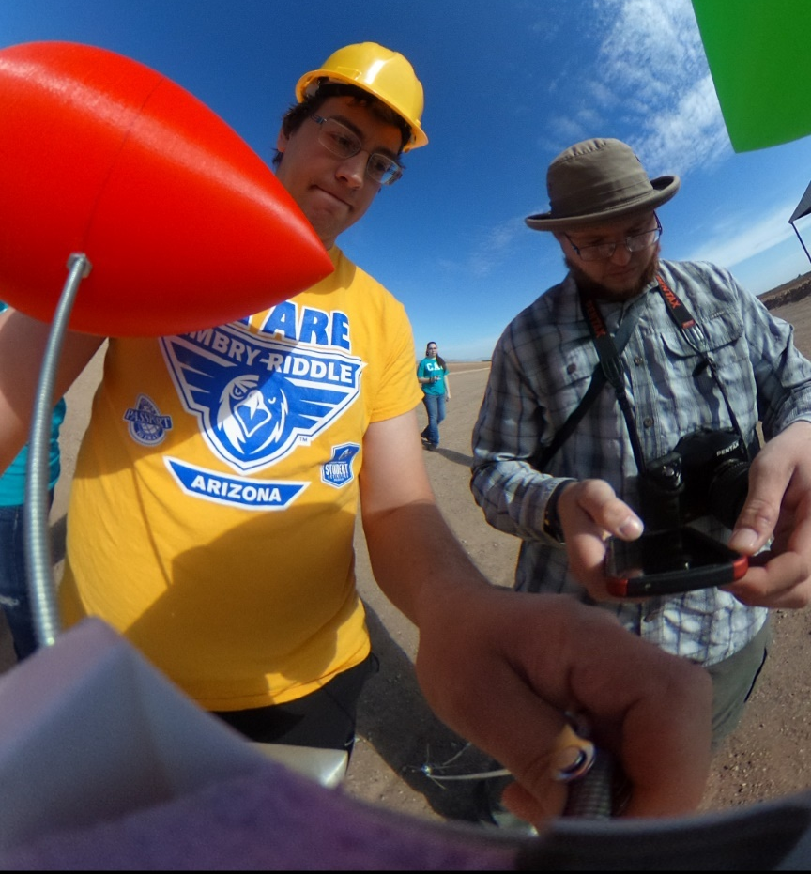
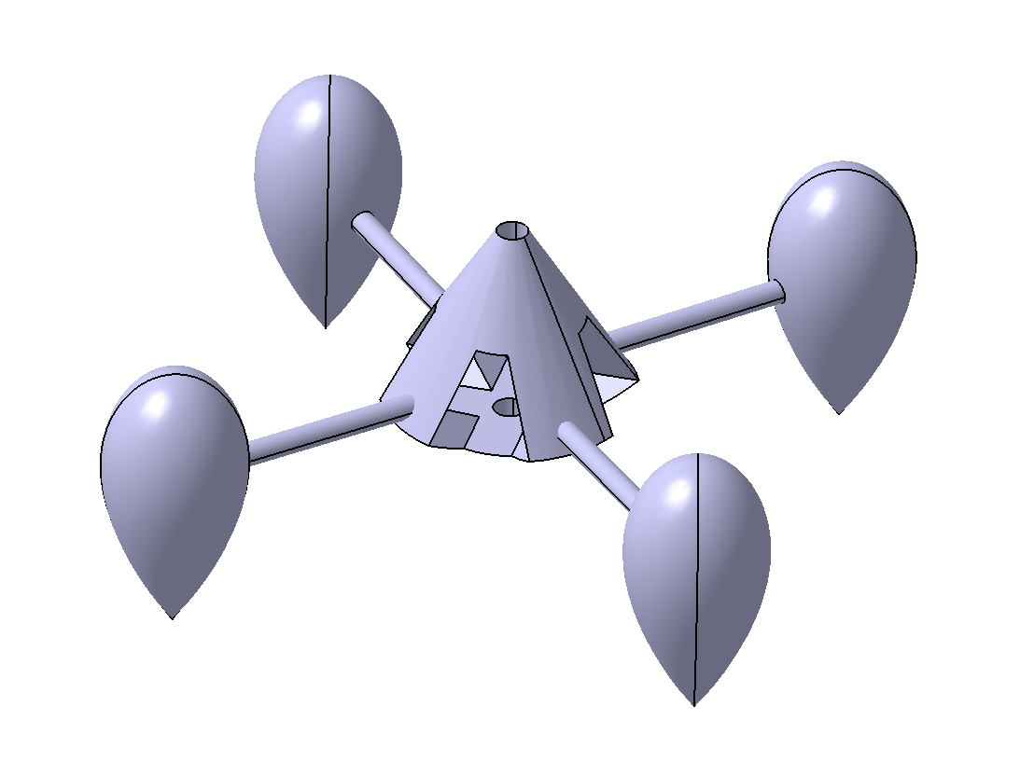
Team Members
Nicholas Mallott – Aerospace Engineering Student
  Team Lead, Structural Design and Integration
Xander Pickard – Mechanical Engineering Student
  Fabrication and Lead Technologist
Jack Crabtree - Mentor

Slide 3
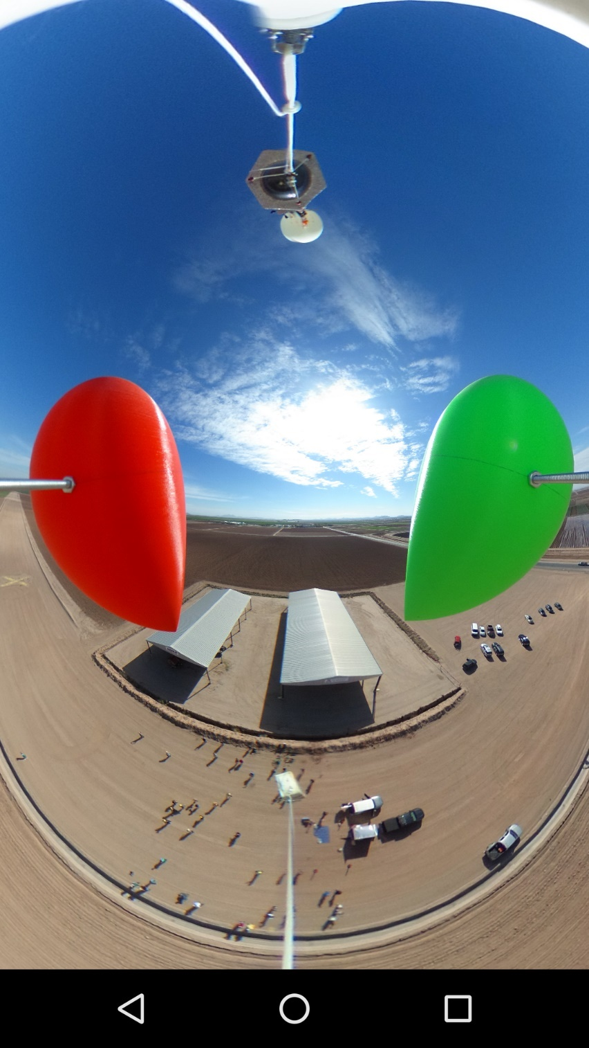
Table of Contents
Problem Statement
Objectives
General Principles
Payload Design
Implementation
Results (Fall + Spring Launches)
Comparative Analysis
Conclusions / Takeaways

Slide 4
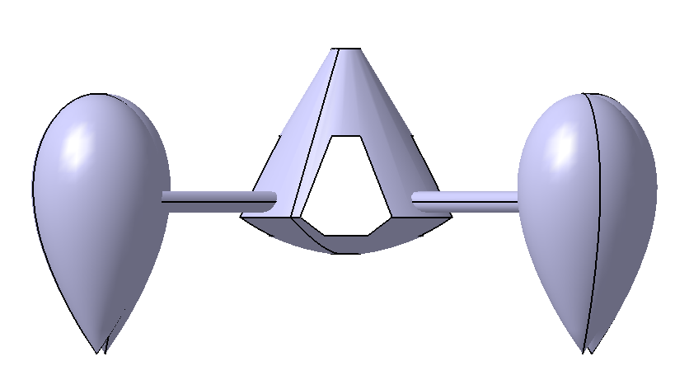
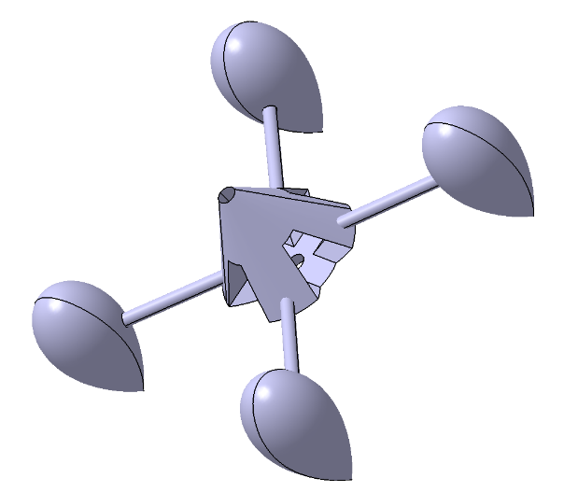
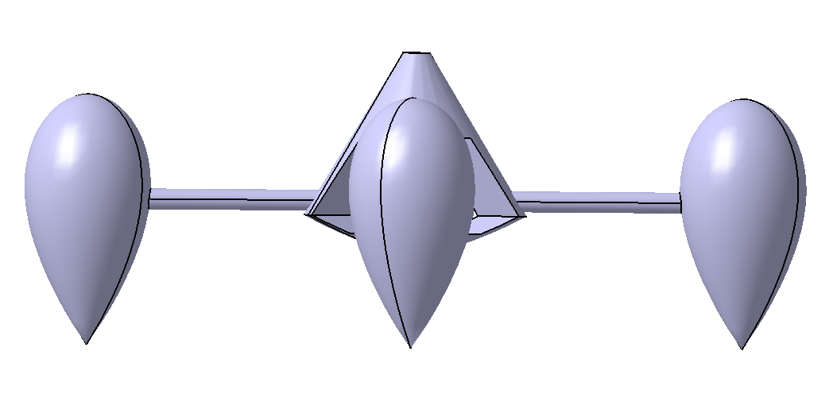
Problem Statement
Balloon controllability
Axial spin / tilt in flight
Rates of acceleration
Rates of spin

Slide 5
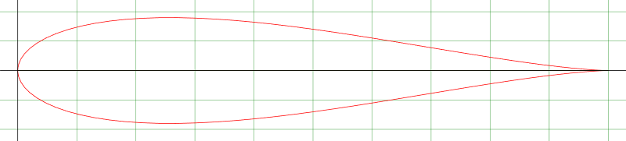
Objectives
Develop a passive control system
Design a system to reduce axial rotation rates
Prevent tilt of system about secondary axes
Reduce acceleration spikes
Build a system to accomplish this using aerodynamic principles

Slide 6
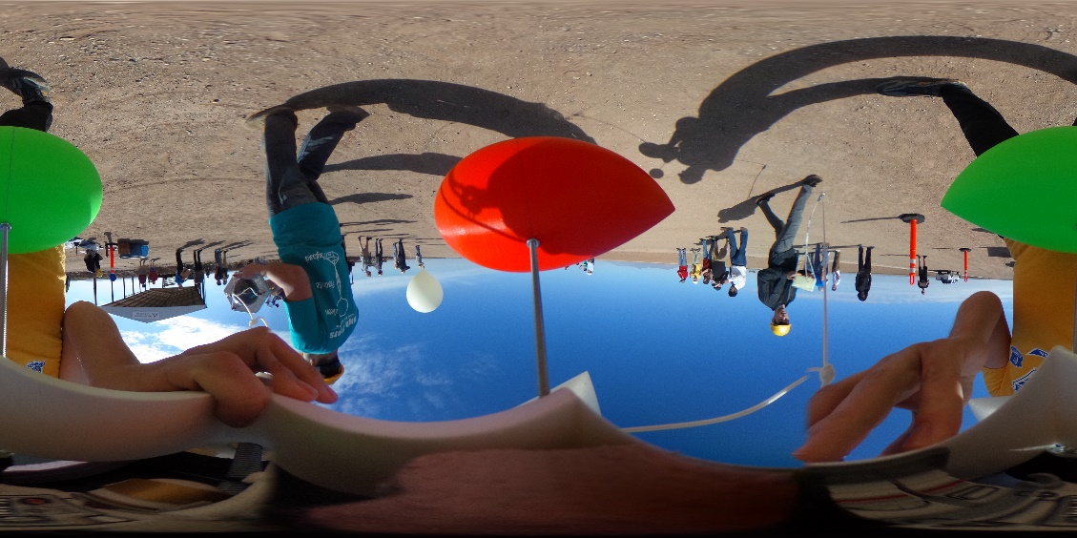
General Principles
Airfoil Designs
  Joukovsky 18% Symmetrical Airfoil
  Joukovsky 15% Symmetrical Airfoil
  Eppler 479 Aerobatic Airfoil
Mass-moment of inertia
Flutter vs Airfoil Design
  Function of Structure, Inertia and Applied Aerodynamic Forces

Slide 7
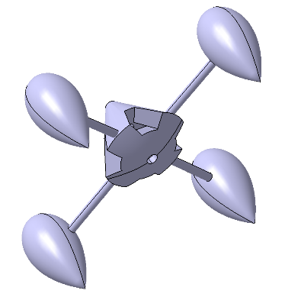
Payload Design
ABS (acrylonitrile butadiene styrene) plastic main chassis for sensors / base
  Stronger, flexible and accuracy
PLA (polylactic acid) for outrigger system
  Lighter, higher rigidity and softer rounding edges
Zinc rods for connectors
Fiberglass center rod
Razor IMU (9-axis sensor)

Slide 8
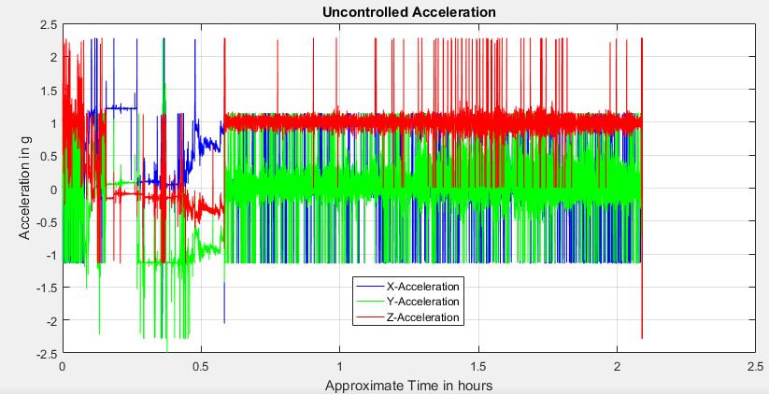
Results (Fall Launch)

Slide 9
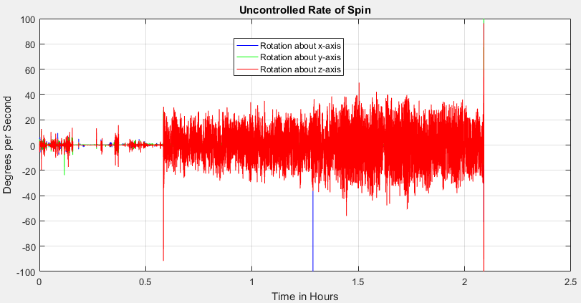
Results (Fall Launch)
Average Ascent Spin = 17.02 degrees per second

Slide 10
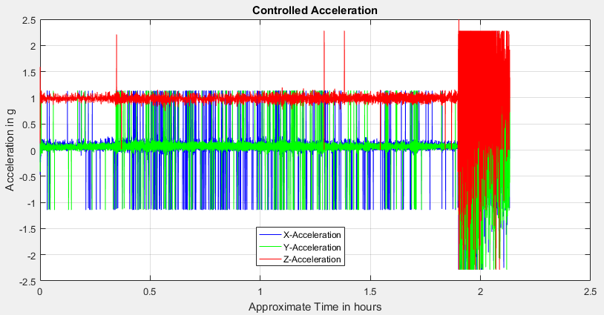
Results (Spring Launch)

Slide 11
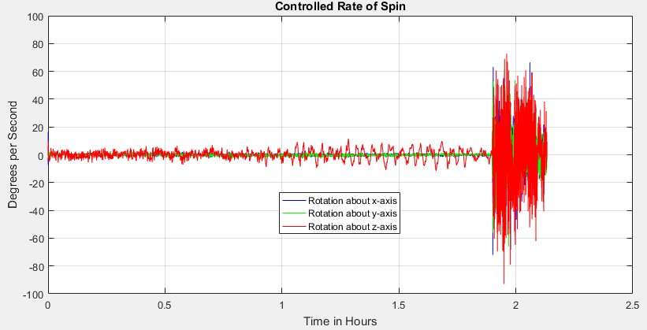
Results (Spring Launch)
Average Ascent Spin = 4.32 degrees per second

Slide 12
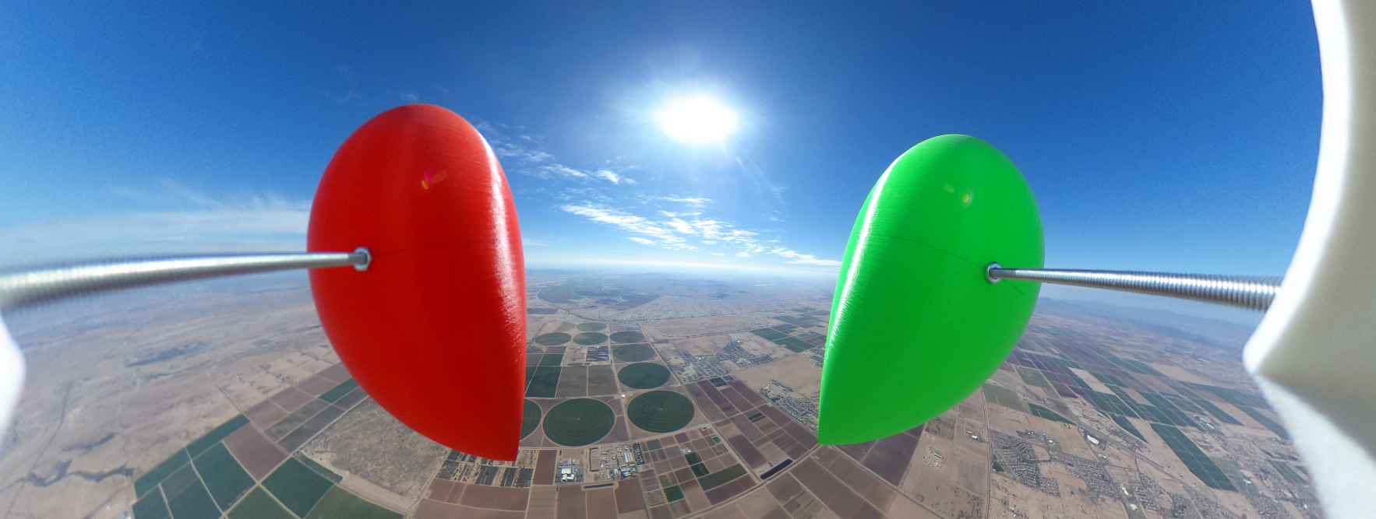
Comparative Analysis
Accelerometer Data:
  Less “noise” throughout ascent
  Reduced number of data spikes
Gyroscope Data:
  Average spin rate decreased by factor of ~4.25
  Noise reduced and spikes reduced significantly

Slide 13
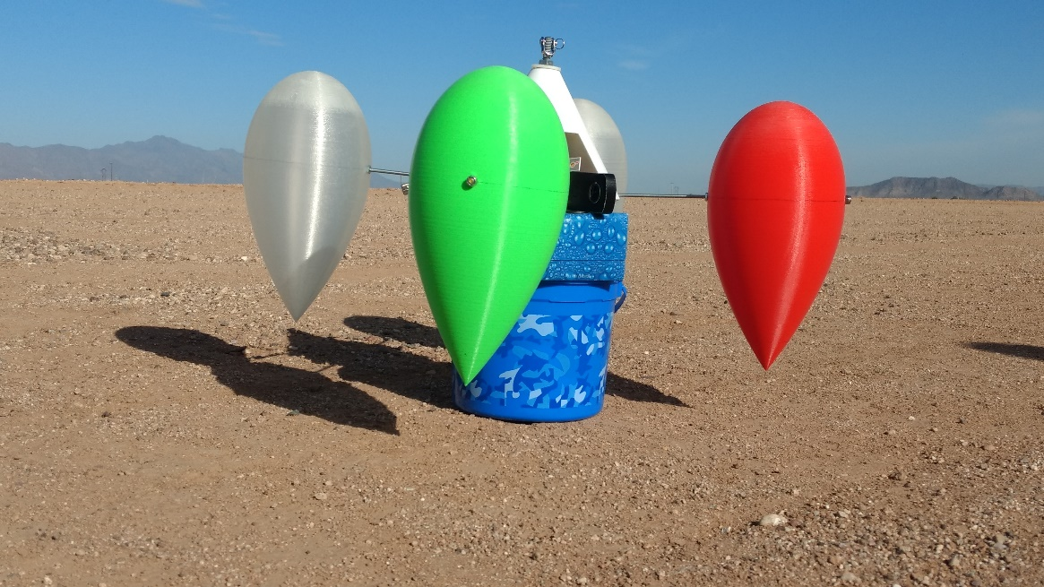
Conclusions / Takeaways
Effective at reduction of spin rates
Reduction of noise in accelerometer and gyroscope data – stabilization of change in rates
Effective for creating a stable platform for additional testing
Eclipse flight on 4/15
implementing design
Potential for control
usage on future flights

Slide 14

Acknowledgements
The Arizona Space Grant Consortium for the support, vision and opportunity to enable this project to carry on
Arizona Near-Space Research for their support of and for the ASCEND! Project, and for their dedication to science and exploration
Embry-Riddle Aeronautical University for their pursuit of excellence, in and out of the classroom
Prof. Jack Crabtree for his continued support, guidance and supervision of this project

Slide 15

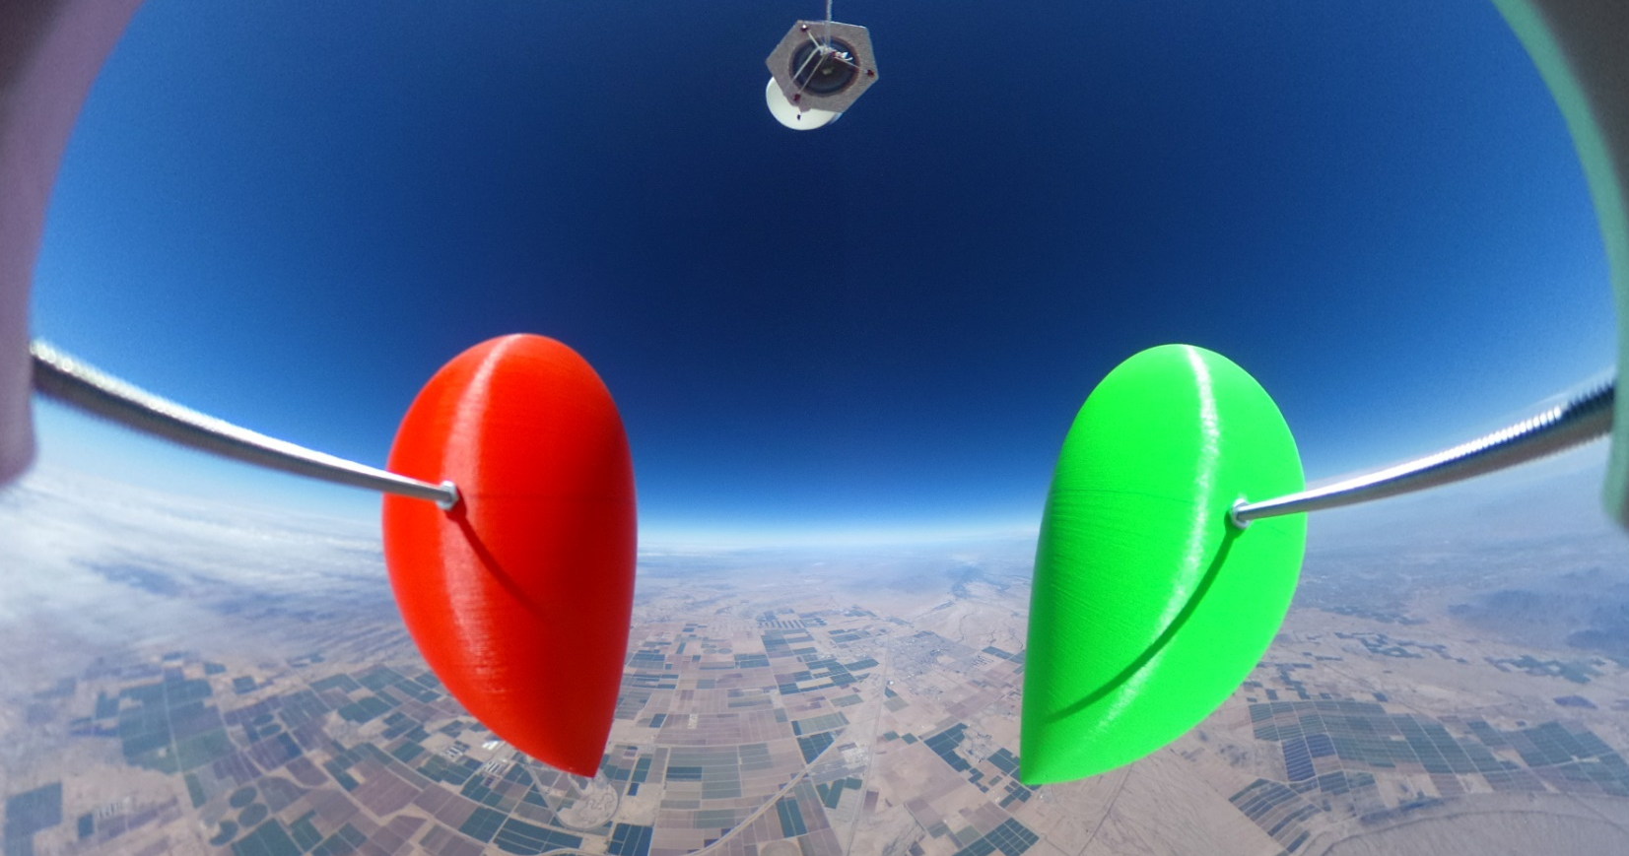
Questions?
Thank you for your support and your time.

Slide 16
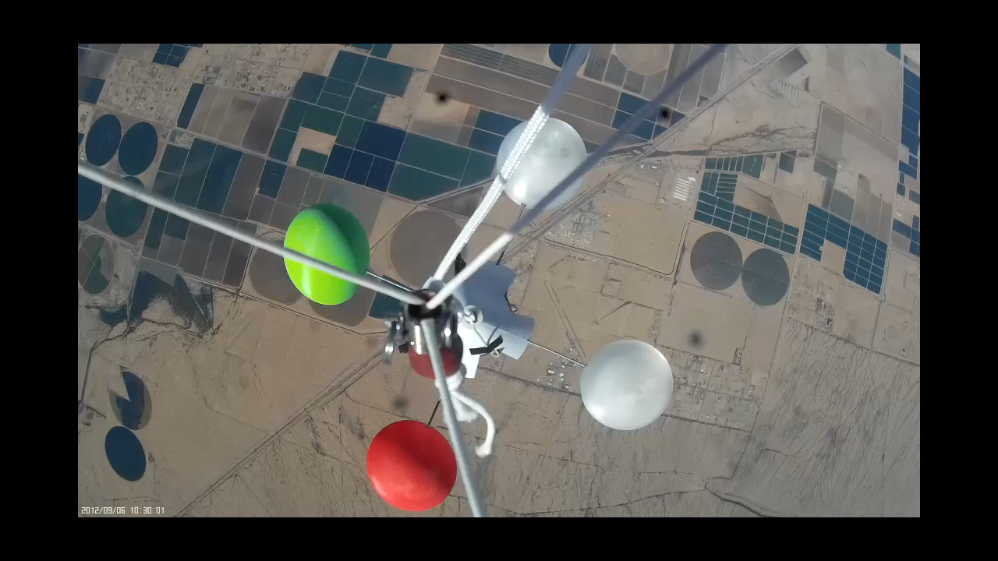
Questions?
Thank you Central Arizona College for this video!!!

Slide 17
Shout outs
Dr. Gary Yale for his continued efforts and guidance as the lead of all Space Grant projects at Embry-Riddle Aeronautical University.
ERAU Eclipse Team for their assistance and compared notes on balloon project endeavors.
Central Arizona College for remarkable video of this team’s Spring Launch payload. We appreciate it!
Staff and Faculty at ERAU who were consulted or who helped in fabrication

Slide 18
Images taken from:
https://theta360.com/en/about/theta/s.html
http://www.ansr.org/
https://www.nasa.gov/
http://spacegrant.pr.erau.edu/
https://spacegrant.arizona.edu/
http://www.airfoiltools.com/airfoil/details?airfoil=e479-il
http://www.airfoiltools.com/airfoil/details?airfoil=joukowsk0015-jf
http://www.airfoiltools.com/airfoil/details?airfoil=joukowsk0018-jf
Template from ASCEND! Team Lead Joseph Mena: Fall 2015 – Spring 2016

Slide 19
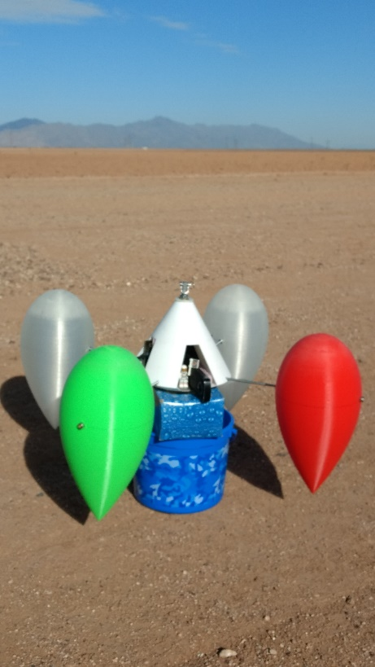
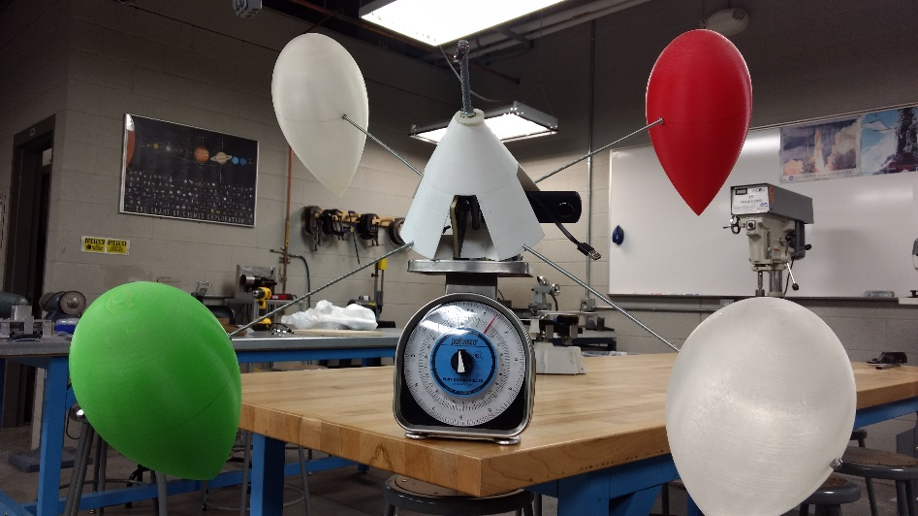

Additional Pictures

Slide 20
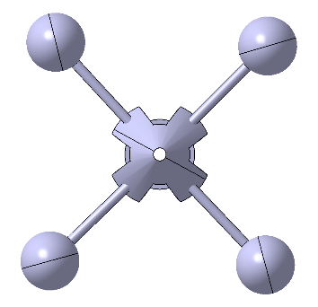

Extra Pics

Slide 21
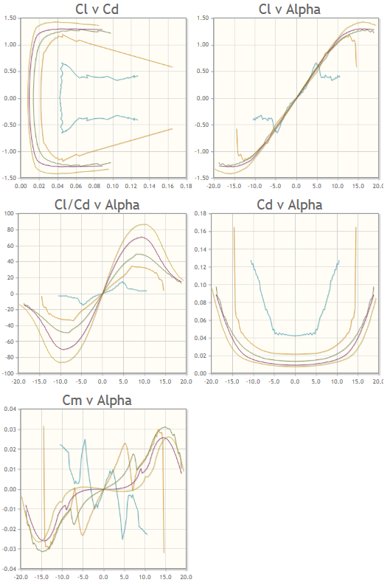
Principles
Expanded
(J – 18%)

Slide 22
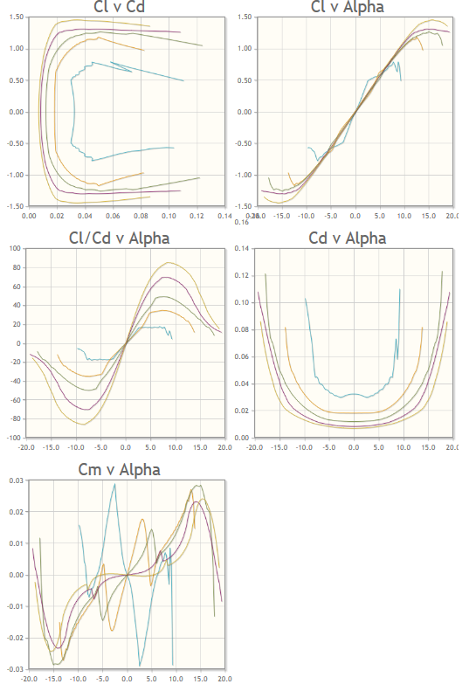
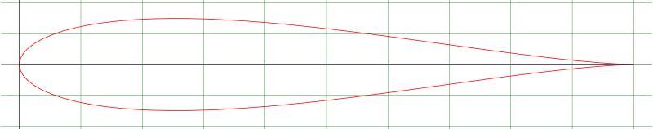
Principles
Expanded
(J – 15%)

Slide 23
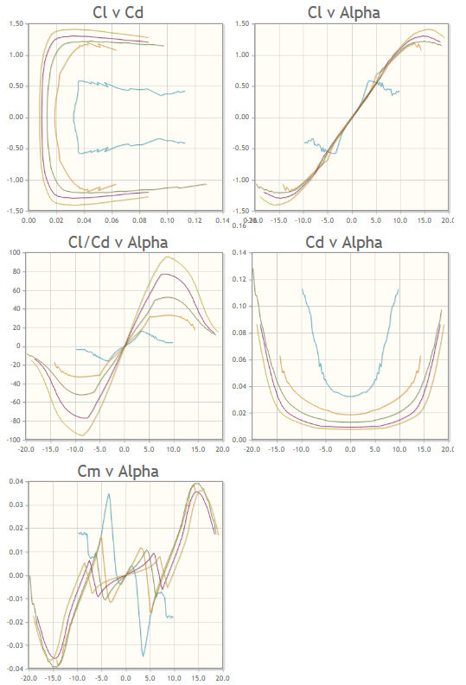
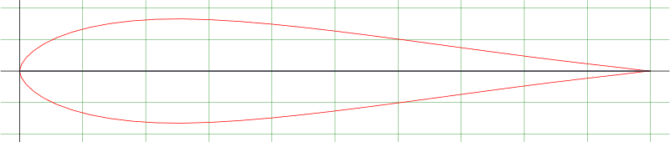
Principles
Expanded
(Eppler)

Slide 24
The Payload
Testing controls systems as they pertain to balloon missions
Implementing passive design via aerodynamic stabilization in tandem with mass moment of inertia manipulation
Interested in:
  Stabilization effects for recording
  IMU (inertial measurement unit) data

Slide 25
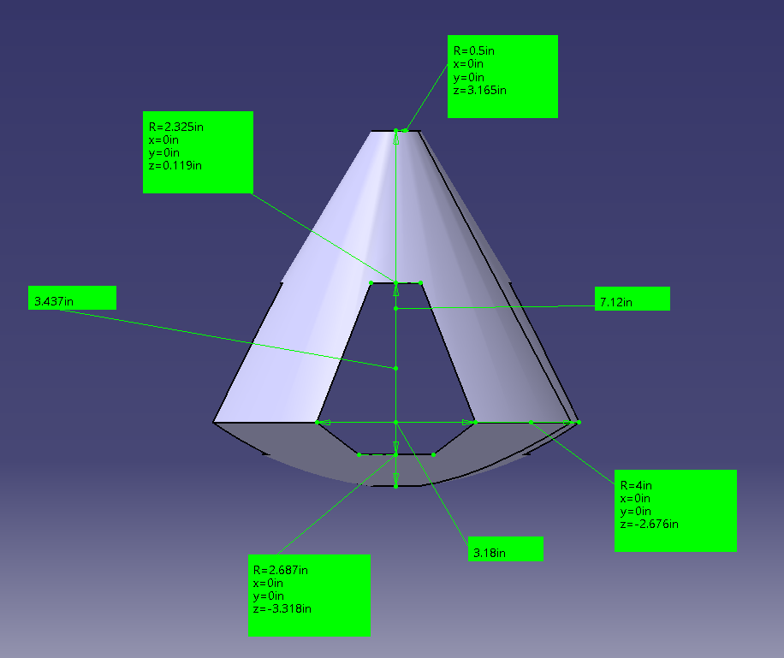
Payload Design (Dimensioning)

Slide 26
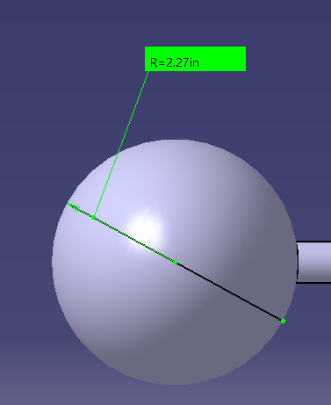
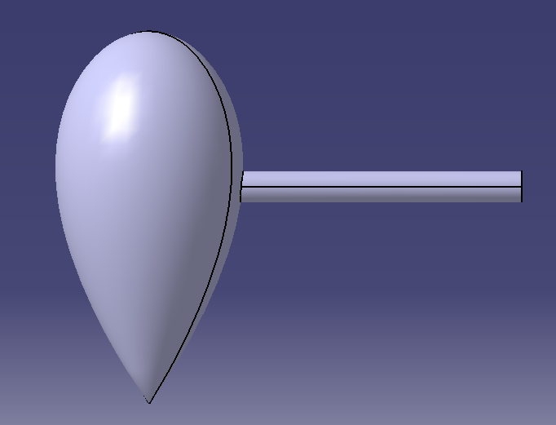
Payload Design (Dimensioning)

Slide 27

Payload Design
Ricoh Theta S
  360 Camera and Video support
  W/o external battery, picture every
  30 seconds for entire flight
  W/ external power, pictures every 10
  seconds with fully charged batteries
  Video capability only up to 25 minutes /
  4 GB until stop time
https://theta360.com/en/about/theta/s.html

Slide 28
Final Payload – 2.942 lbs
ABS Main Chassis
4x PLA Outriggers
4x Zinc Threaded Rods
Ricoh Theta S – 360 Camera
Razor IMU – Accelerometer/ Gyroscope Readings
Carbon-Composite Bolting Board
Fiberglass Core Securing Rod
External Batteries

